Slide 1
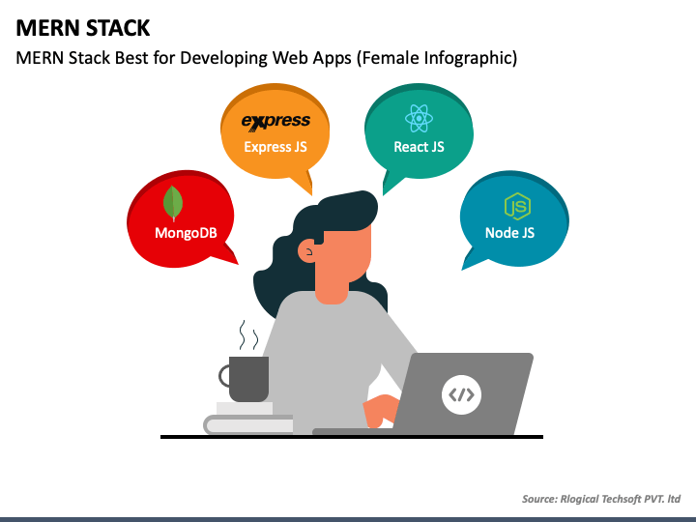
MERN STACK
MERN stack is a collection of technologies that enables faster application development.
It is used by developers worldwide.
The main purpose of using MERN stack is to develop apps using JavaScript only.
MERN Stack is a JavaScript Stack that is used for easier and faster deployment of full-stack web applications.

Slide 2
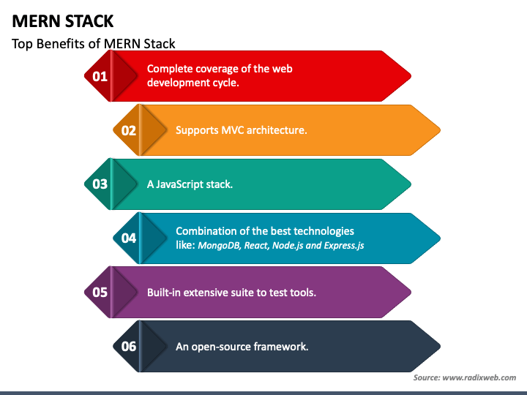
All technologies that are involved in MERN are open-source. This feature allows a developer to get solutions to queries that may evolve during development, from the available open portals. As a result, it will be beneficial for a developer. As everything is written in one language this is why MERN is simple and fast.

Slide 3
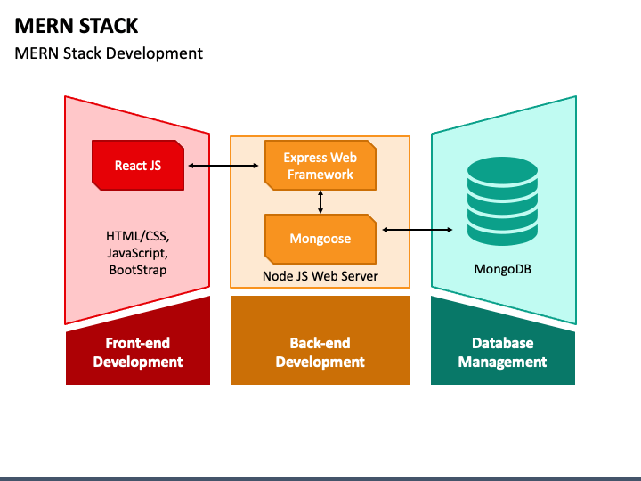

Slide 4
React js:-
React is a declarative, efficient, and flexible JavaScript library for building user interfaces.
The React.js framework is an open-source JavaScript framework and library developed by Facebook.
It’s used for building interactive user interfaces and web applications quickly and efficiently with significantly less code than you would with vanilla JavaScript.
Node js:-
Node.js is an open-source, cross-platform JavaScript runtime environment and library for running web applications outside the client's browser
Express web framework:-
Express is a node js web application framework that provides broad features for building web and mobile applications.
It is used to build a single page, multipage, and hybrid web application
Mongoose:-
Mongoose provides a straight-forward, schema-based solution to model your application data
Mongoose is a Node.js-based Object Data Modeling (ODM) library for MongoDB.
Mango DB:-
MongoDB is an open source NoSQL database management program
MongoDB is a NoSQL database that enables developers to manage the databases of web applications. It is used in the MERN stack to record documents of key-value pairs that are similar to JSON. It's flexible and allows developers to create schema, tables, databases, etc.

Slide 5
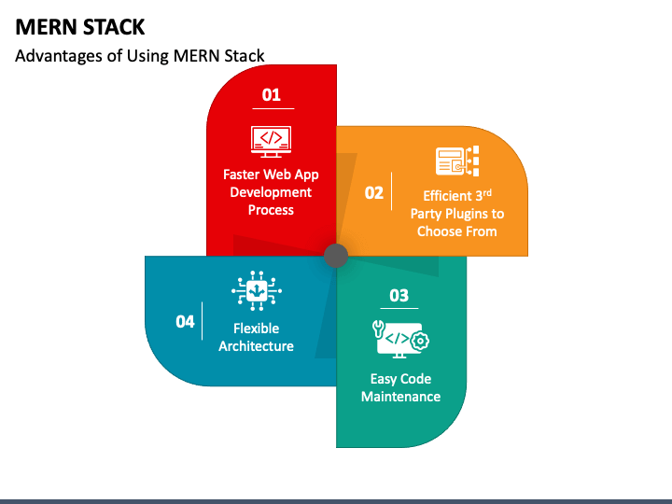

Slide 6
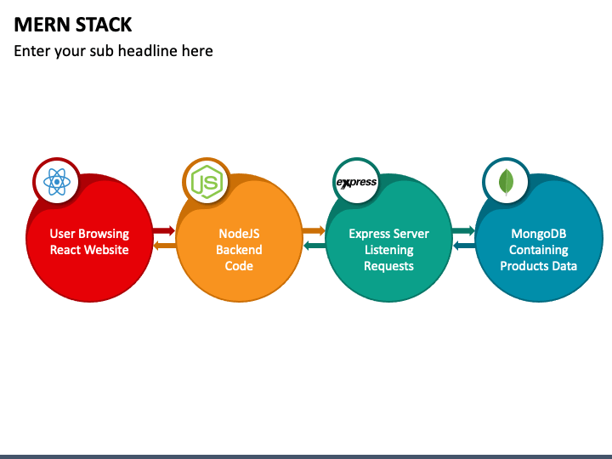

Slide 7
